Slide 1
Mapping & Configuration Files in Hibernate
Created by : Prashant Chauhan

Slide 2
Details of Mapping & Configuration
→ Mapping:
Mapping file is the heart of hibernate application.
Every ORM tool needs this mapping, mapping is the mechanism of placing an object properties into column’s of a table.
Mapping can be given to an ORM tool, → Either in the form of an XML
→ In the form of the @Annotations.
The mapping file contains mapping from a pojo class name to a table name and pojo class variable names to table column names.
While writing an hibernate application, we can construct one or more mapping files, mean a hibernate application can contain any number of mapping files

Slide 3
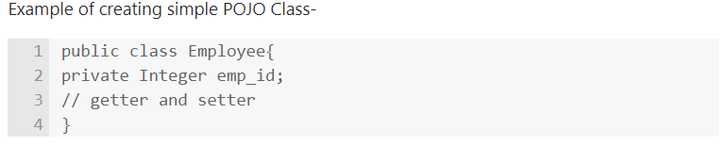
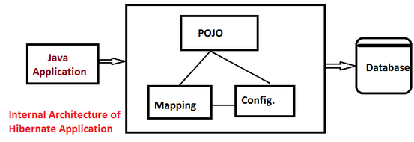
Mapping
→ Plain old java object. (POJO’s basically defines the entity.)
An object contains 3 properties like
Identity (Object Name)
State (Object values)
Behavior (Object Methods)
Mapping can be done using 2 ways,
→ XML
Annotations. [Introduced into java from JDK 1.5.]
Syntax Of Mapping xml:
<hibernate-mapping> <class name="POJO class name" table="table name in database"> <id name="variable name" column="column name in database" type="java/hibernate type" /> <property name="variable1 name" column="column name in database" type="java/hibernate type" /> <property name="variable2 name" column="column name in database" type="java/hibernate type" /> </class> </hibernate-mapping>

Slide 4



Configuration
Configuration is the file loaded into an hibernate application,
→Configuration file contains 3 types of information..
Connection Properties
Hibernate Properties
Mapping file name(s)
We must create one configuration file for each database we are going to use, suppose if we want to connect with 2 databases, like Oracle, MySql, then we must create 2 configuration files.
N number of database
= That many number of configuration files

Slide 5
Configuration
We can write this configuration in 2 ways…
→ XML
By writing Properties file. We don’t have annotations here, in hibernate 1.x, 2.x we defined this configuration file by writing .properties file, but from 3.x xml came into picture.
Now, finally
Mapping –> xml, annotations
Configuration –> xml, .properties (old style)

Slide 6
Configuration : Syntax Of Configuration xml:
<hibernate-configuration> <session-factory> <!-- Related to the connection START --> <property name="connection.driver_class">Driver Class Name </property> <property name="connection.url">URL </property> <property name="connection.user">user </property> <property name="connection.password">password</property> <!-- Related to the connection END --> <!-- Related to hibernate properties START --> <property name="show_sql">true/false</property> <property name="dialet">Database dialet class</property> <property name="hbm2ddl.auto">create/update or what ever</property> <!-- Related to hibernate properties END--> <!-- Related to mapping START--> <mapping resource="hbm file 1 name .xml" / > <mapping resource="hbm file 2 name .xml" / > <!-- Related to mapping END --> </session-factory> </hibernate-configuration>
Usually configuration file name will be hibernate.cfg.xml

Slide 7
Simple Hibernate Application Requirements
→ Any hibernate application, E.g. consider even first hello world program must always contains 4 files totally.
POJO class - ( Employee.java )
Mapping XML - ( Product.hbm.xml )
Configuration XML – ( hibernate.cfg.xml )
One java file to write our logic – (OurMainMethod.java )
In hibernate application, (Number of POJO classes = that many number of mapping xmls), only one configuration xml and one java file to write our logic.

Slide 8
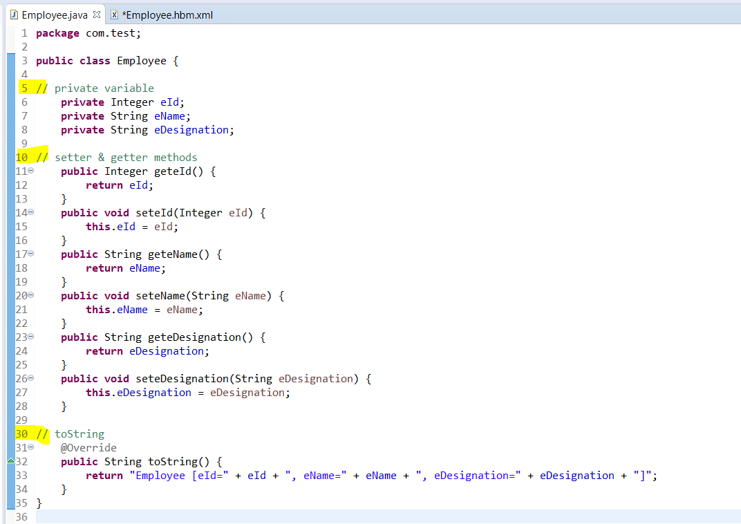
→ POJO Class:
POJO is a simple java file, no need to extend any class or implement any interface.
This POJO class contain private properties variables, and for each property a //getter and a //setter
Example:- Employee.java

Slide 9
Mapping xml For POJO:
Mapping file related to above pojo class
Employee.hbm.xml
For eDesignation property we have not written any column name, we only specified <property name=" eDesignation"/> This means in the database the column name for eDesignation property will also be eDesignation, in these cases we can ignore the column attribute to write.
This is the default generator class used by the hibernate
If generator class is assigned, then the programmer is responsible for assigning the primary key value to object which is going to save into the database
<hibernate-mapping>
<class name="Employee" table="EmployeeTable">
<id name="eId" column="ENo">
<generator class="assigned" />
</id>
<property name="eName" column="EName" />
<property name="eDesignation"/>
</class>
</hibernate-mapping>
Types of <generator />

Slide 10
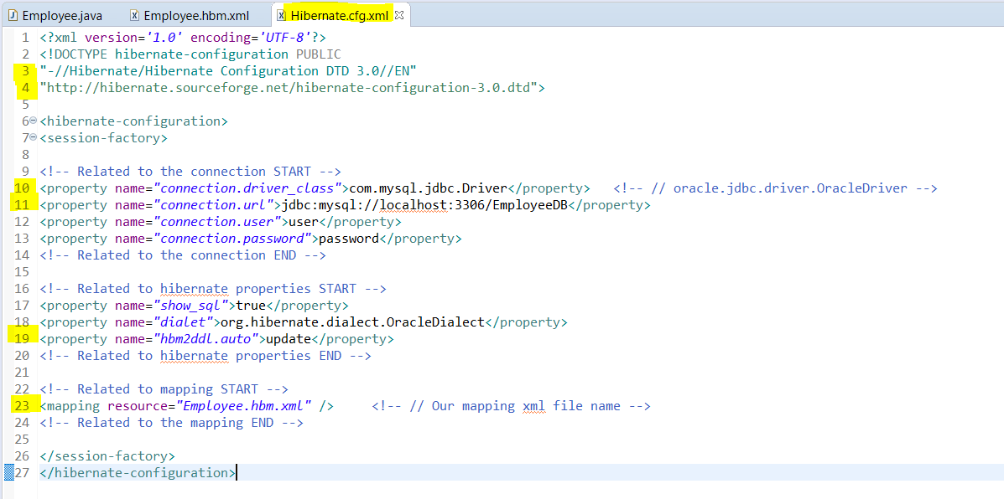
Configuration XML
Example : Hibernate.cfg.xml

Slide 11
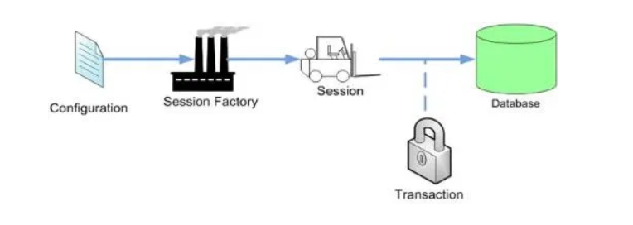
Thank You!!

